Slide 1
Analysis of current inflation sentiments in the US political society
Jignesh Jatakia, jignesh.jatakia@student.tugraz.at (BA major) Jigna Jatakia, jigna.jatakia@student.tugraz.at (IT major) Artyom Kukushkin, artem.kukushkin.02@gmail.com (EM major) Ihor Savchenko, igor.savchenko@tavr.at (BA major)

Slide 2
Hypotheses to test
1. The tweets dedicated to inflation have significantly more impact (retweets and quotes) than average tweets of the same authors within the same period.
2. The tweets dedicated to inflation are marked by significantly stronger negative sentiment than average tweets of the same authors within the same period.
3. The medium sentiment of pundit tweets correlates with the US inflation statistics in the same period.

Slide 3

Data and methods
US political pundits/journalists (https://twitter.com/i/lists/15084461/members);
Leave those with > 10000 followers, > 1000 tweets, last tweet no earlier than Feb 1;
Retrieve 300 latest tweets for each one;
Leave only tweets for 2022;
In total, 30182 tweets written by 253 pundits;
From them, pick tweets mentioning inflation OR prices OR gas;
211 tweets – our „inflation sample“
Collect timelines with twarc;
Assess sentiments with VADER;
For sentiments (qualitative data): tests of independence between the inflation sample and the non-inflation part with a chi-square test;
For impact (quantitative data): calculate means for the inflation sample and the general population, then compare them using a Z-test;
Find the correlation between general sentiments and the inflation rate in the US across 2022, grouped by months.

Slide 4

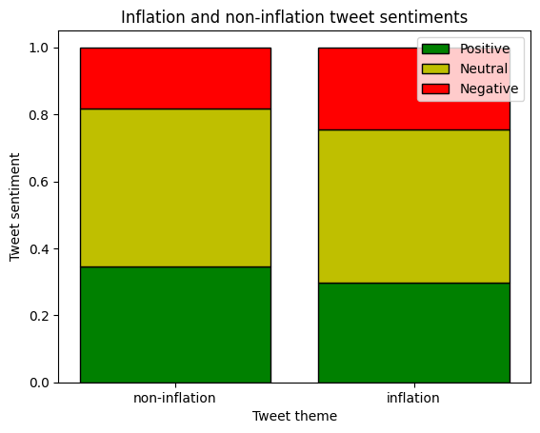
Chi-square test for sentiments and Z-test for impact
Chi-square test:
test-value = 0.013 with a critical value 5.99 -> H0 holds
Z-test:
population mean = 0.0118 sample mean = 0.0227
p-value = 0.513 -> H0 holds

Slide 5

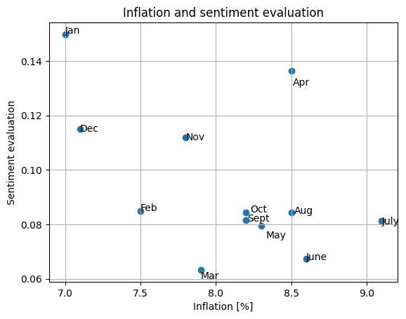
2022: correlation between inflation and general sentiments = -0.536

Slide 6

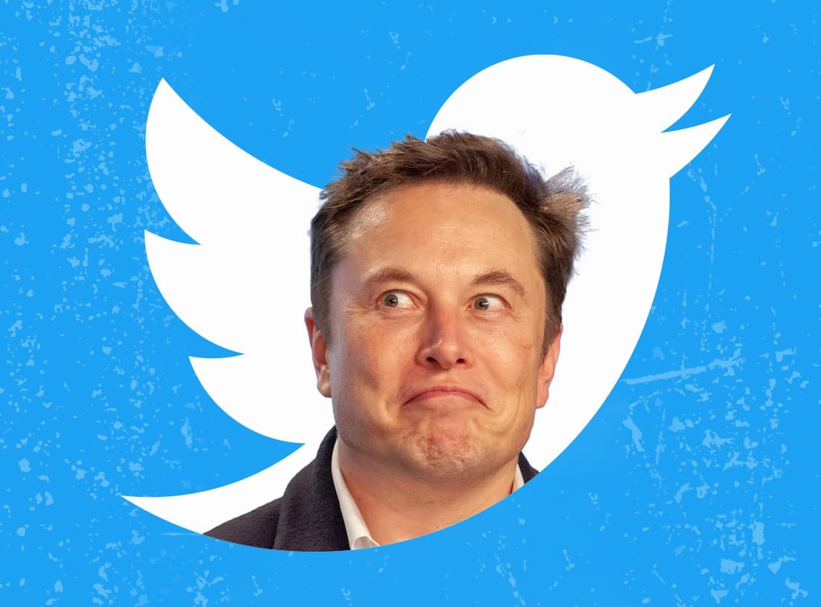
Conclusions
Although visual data show slight changes between the sample and the rest/general population, these changes are not statistically significant (we cannot reject the null hypothesis);
One should take into account the imperfection of data gathering and analysis methods (e. g. a tweet praising an external article about inflation is deemed „positive“, while the article subject itself is clearly negative);
Correlational analysis shows moderate negative correlation between the inflation level and general sentiments in the Twitter expert group. This is logical, but the question still needs more data for precise analysis (only 12 months is not enough);
April 2022 is an outlier – probable “Elon Musk effect”? ☺

